Slide 1
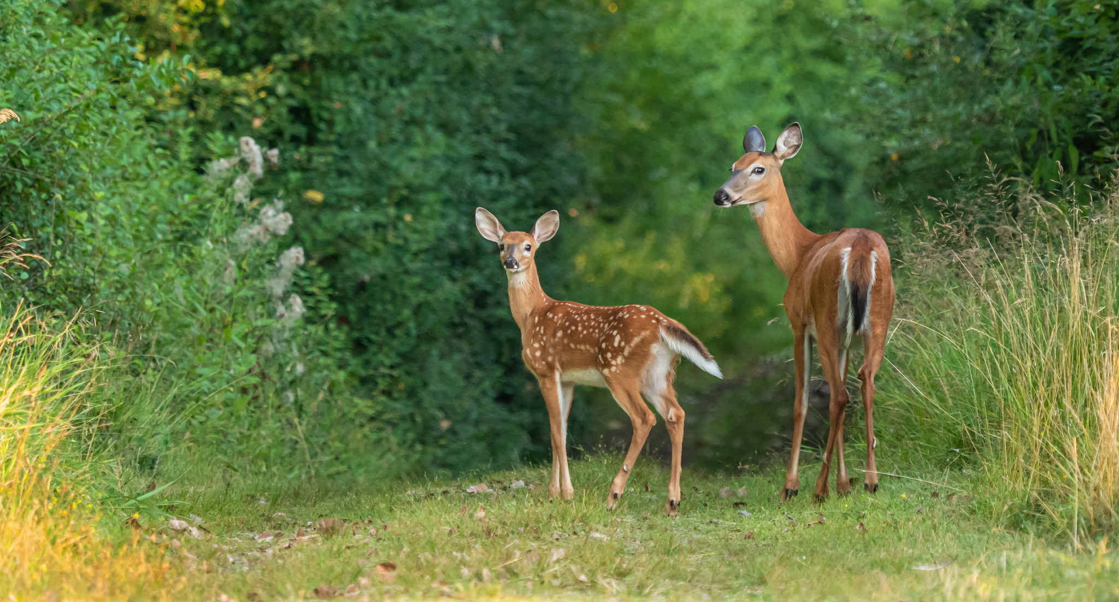
Selling of
Venison
in Stores
By: Eli, Katarina, Lillie, Stesha, and Vianca

Slide 2
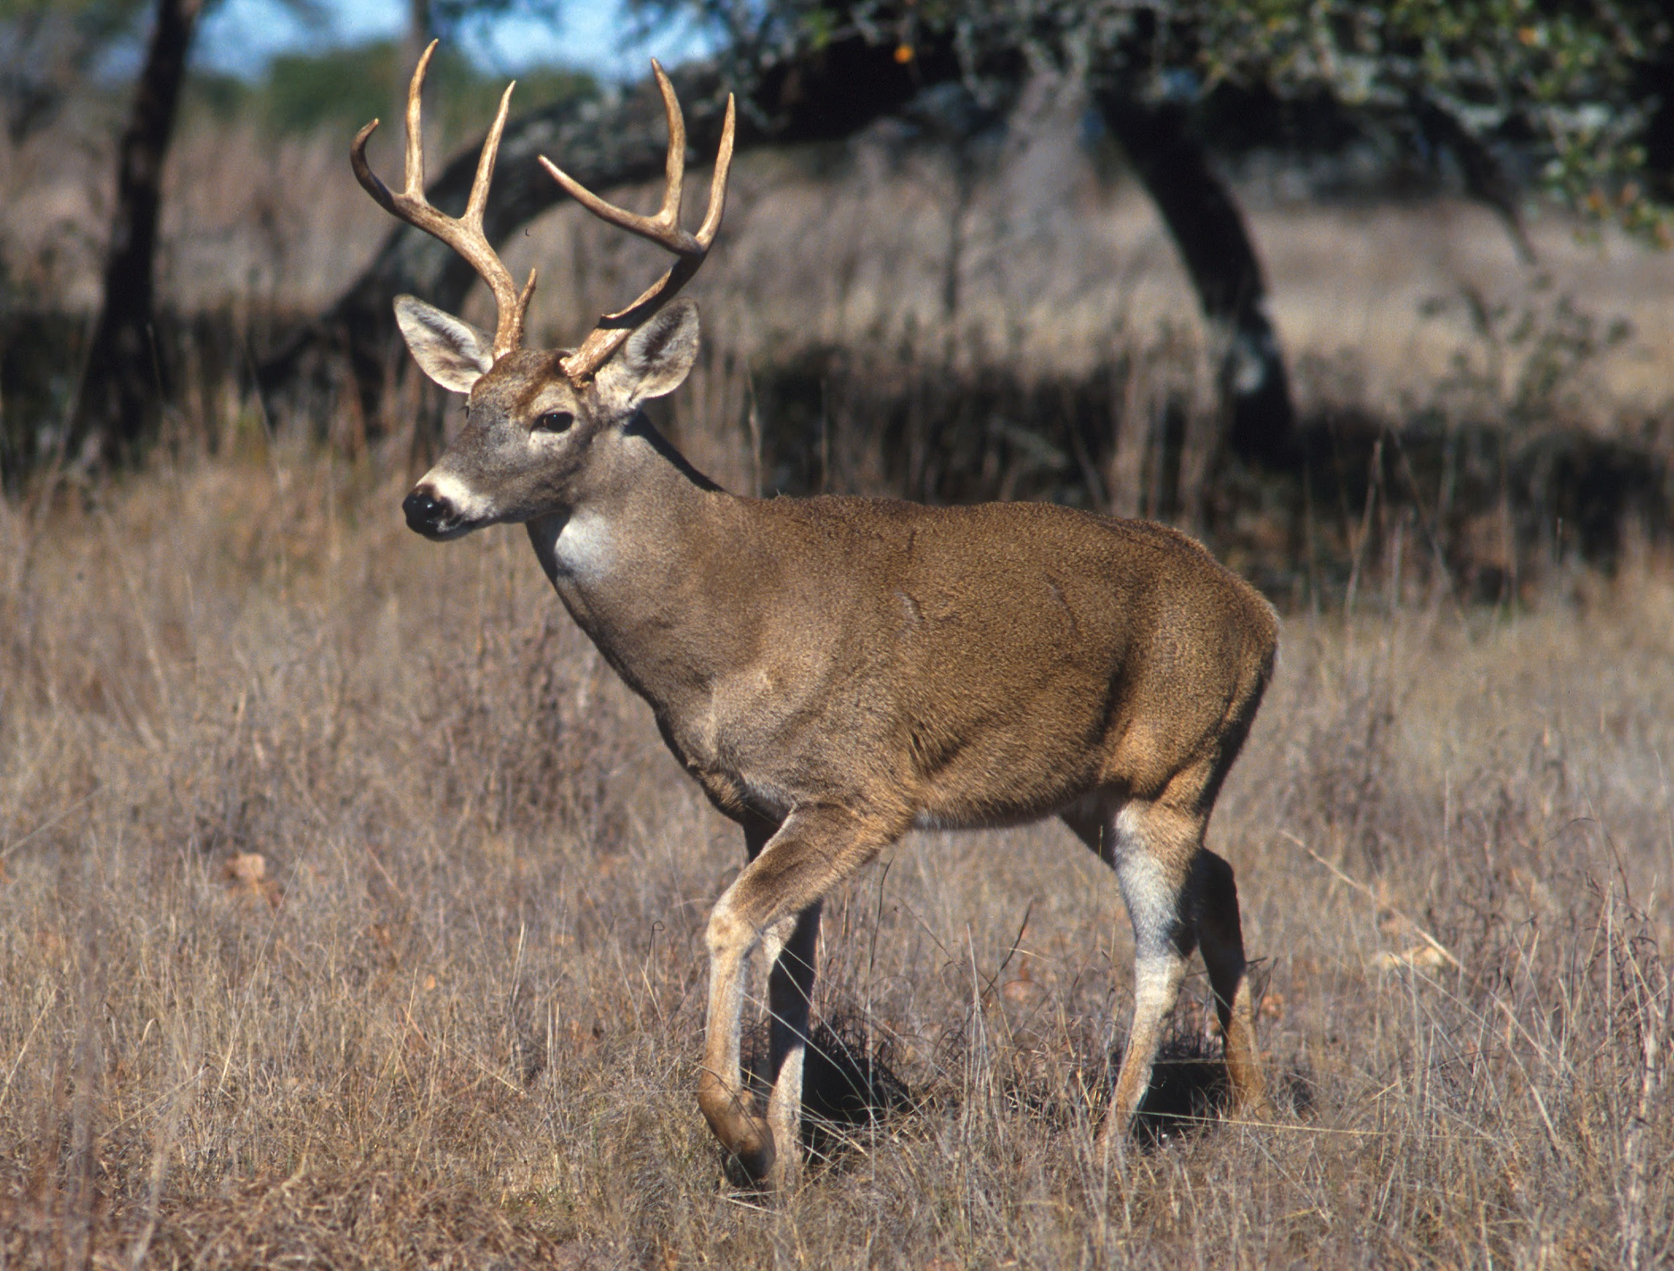
Introduction
Health concerns
Economic concerns
Governmental control
American perception of wildlife

Slide 3
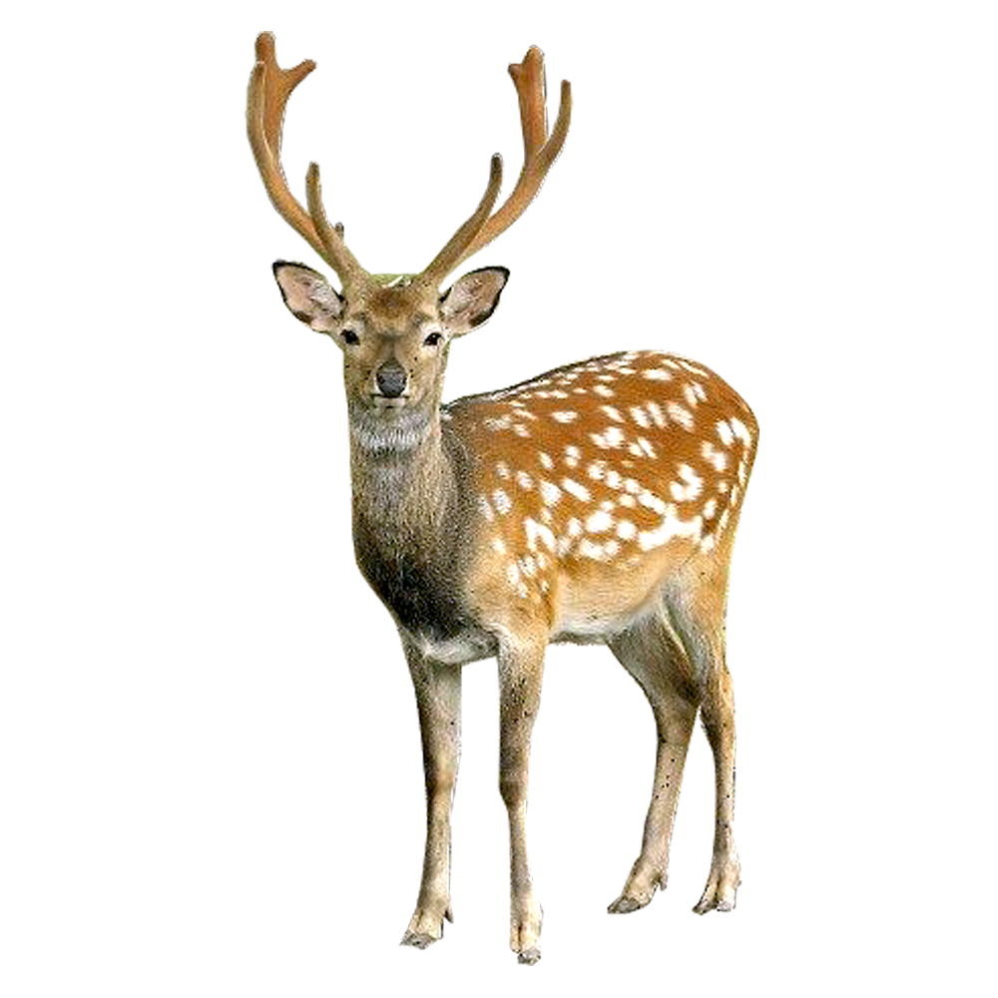
North American Model of Wildlife Conservation (NAMWC)
Created in the late 19th century, in response to the exploitation and overhunting of wildlife populations within North America
A system of policies and laws consisting of 7 tenets
Tenet 2 states: Markets for game are eliminated.
-therefore making the sale of game meat illegal, including venison
White-tailed deer populations have grown tremendously throughout the past few decades
Many argue Tenet 2 is no longer beneficial from both an ecological and social standpoint
(Pendergast, 2016) (Lawrence, 2022)

Slide 4
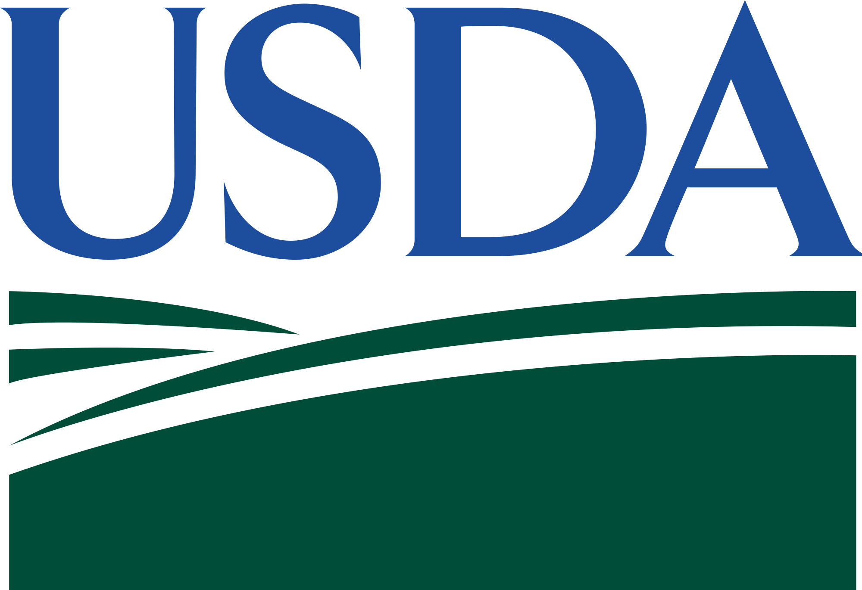
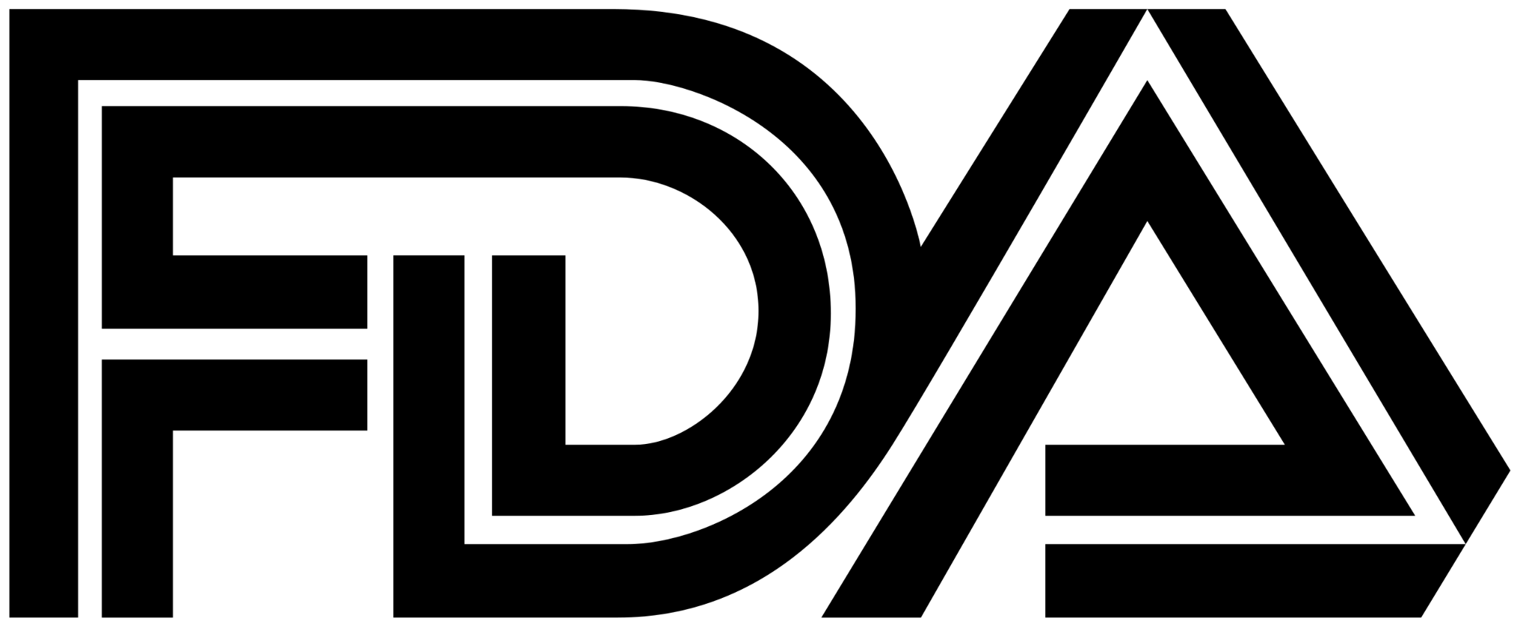
Health Regulations & Management
Processing of wild game meat is under NYS DEC
Anyone can process their own meat without regulation but cannot trade for goods or services
Venison Donation Program
20-C Food Processing License
Wholesale venison must be vet certified and processed in a regulated slaughterhouse
FDA is involved in wholesale regulation
Meat Inspection Act
Never included venison
Concerns regarding quality of wild caught venison
(Wulf, 2022)

Slide 5
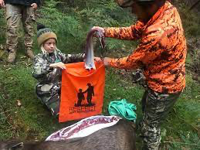
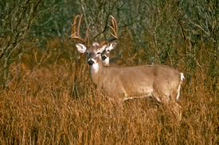
Social & Ecological
Deer destroy habitats by eating much of the understory vegetation seen in forests
-overgrazing forests(Beech vs Maple)
-destroy gardens(become “pests”)
Knowing the origin of where the animal came from(happy, healthy, etc.)
Hunting morals
Interested in venison but do not want to hunt and kill the deer themselves
(Haspel, 2021)
(Hill, 2016)

Slide 6
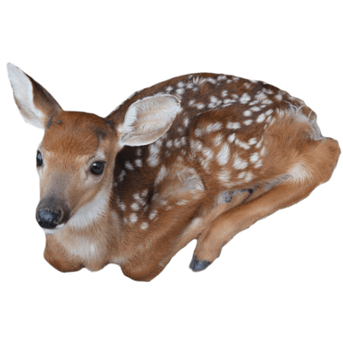
Economic
43% of Americans have eaten wild game in the previous year, but the majority if this meat is raised on farms
An estimated 36 million deer live in the US, yet roughly 85% of the venison sold in restaurants is imported from New Zealand
Deer hunters contribute $23 billion to the economy, over $1.8 billion of which contributes to conservation
Allowing venison to be sold in stores could be a major boost to the economy, and could even support conservation
(Eggenschwiler, 2013)

Slide 7
Current Political Climate
Scientists agree - venison should be able to be sold!
Other incentives haven’t effectively controlled white-tailed deer populations
New proposed incentive from the Wildlife Society would
Involved highly trained personnel
Target deer in otherwise unhunted areas
Allow hunters to sell venison and its byproducts
Others aren’t so sure…
(Sterba, 2013)

Slide 8
Conclusion
The North American Model prevents the sale/distribution of venison as seen in the tenets.
Not allowing the public to sell deer that they kill creates this concept of privatization.
Due to factors like health regulation, economic reasoning, and government regulations, the sale of venison has been illegal.
Even though deer is wildlife and wildlife is a public resource, the sale of venison is prohibited which can be considered unfair to the public.
The NAM can be altered in order to allow the sale of venison so that hunters or others can use this public resource without there being constraints.

Slide 9
References:
Eggenschwiler, B. 2013, October 19. Venison sale restrictions should be loosened, some say. Dow Jones & Company. https://www.wsj.com/articles/SB10001424052702304410204579139424081224050.
Haspel, T. 2021, September 24. Perspective | Venison is the most eco-friendly food on the planet - if you hunt the deer yourself. WP Company. https://www.washingtonpost.com/food/2021/09/23/venison-eco-friendly-hunting/.
Hill, T. 2016, August 12. Why commercial venison sales are banned in Texas. https://www.texasstandard.org/stories/why-commercial-venison-sales-are-banned-in-texas/.
Lawrence, B. 2022, April 4. North American model of wildlife conservation: Wildlife for everyone: U.S. fish &amp; wildlife service. https://www.fws.gov/story/2022-04/north-american-model-wildlife-conservation-wildlife-everyone.
NYS DEC. 2022. Venison Donation. https://www.dec.ny.gov/outdoor/8351.html.
Pendergast, T. H., S. M. Hanlon, Z. M. Long, A. A. Royo, and W. P. Carson. 2016. The legacy of deer overabundance: Long-term delays in herbaceous understory recovery. Canadian Journal of Forest Research 46:362–369.
Sterba, J. 2013, October 19. If Only Hunters Could Sell Venison. Wall Street Journal.
Wulf, K., and M. Wulf. 2022, November 23. Venison Health Regulation. personal.

Slide 10
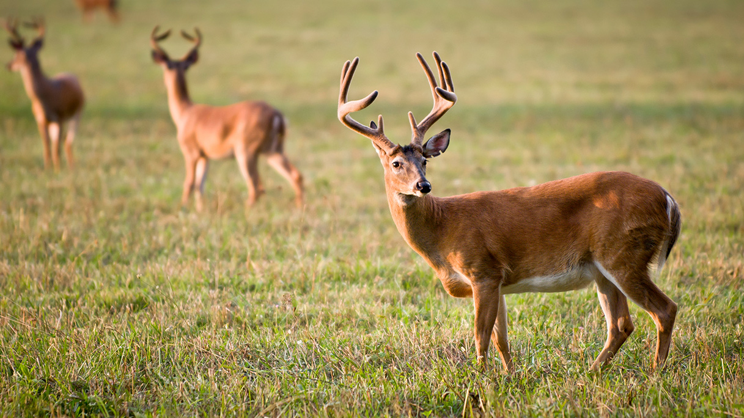
Any Questions?

